Slide 1
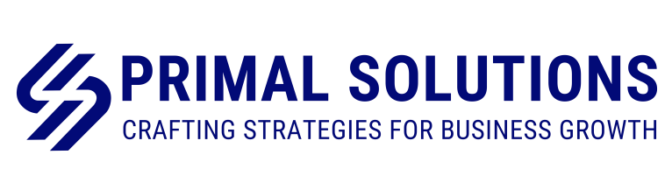
Website Content
Primal Solutions

Slide 2

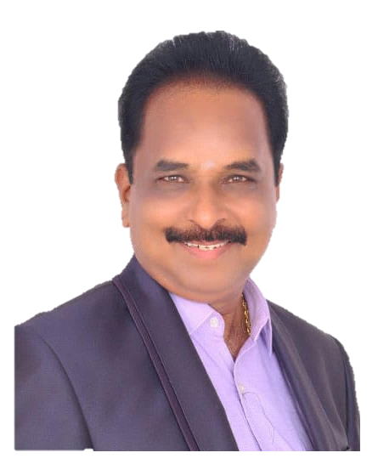
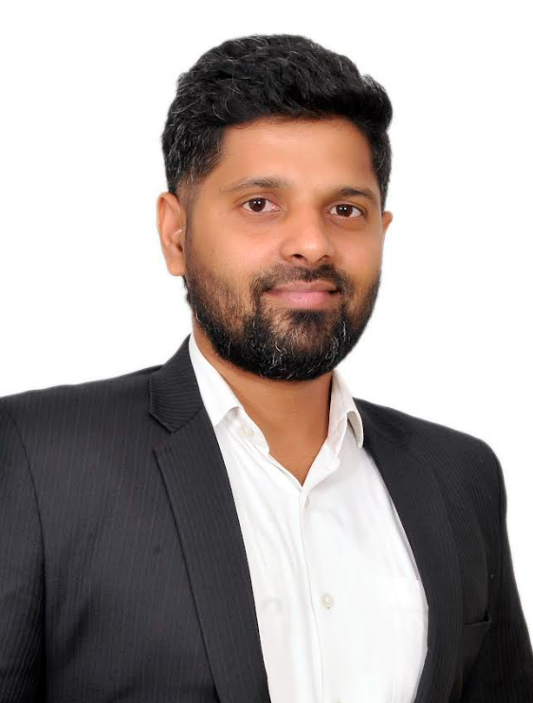
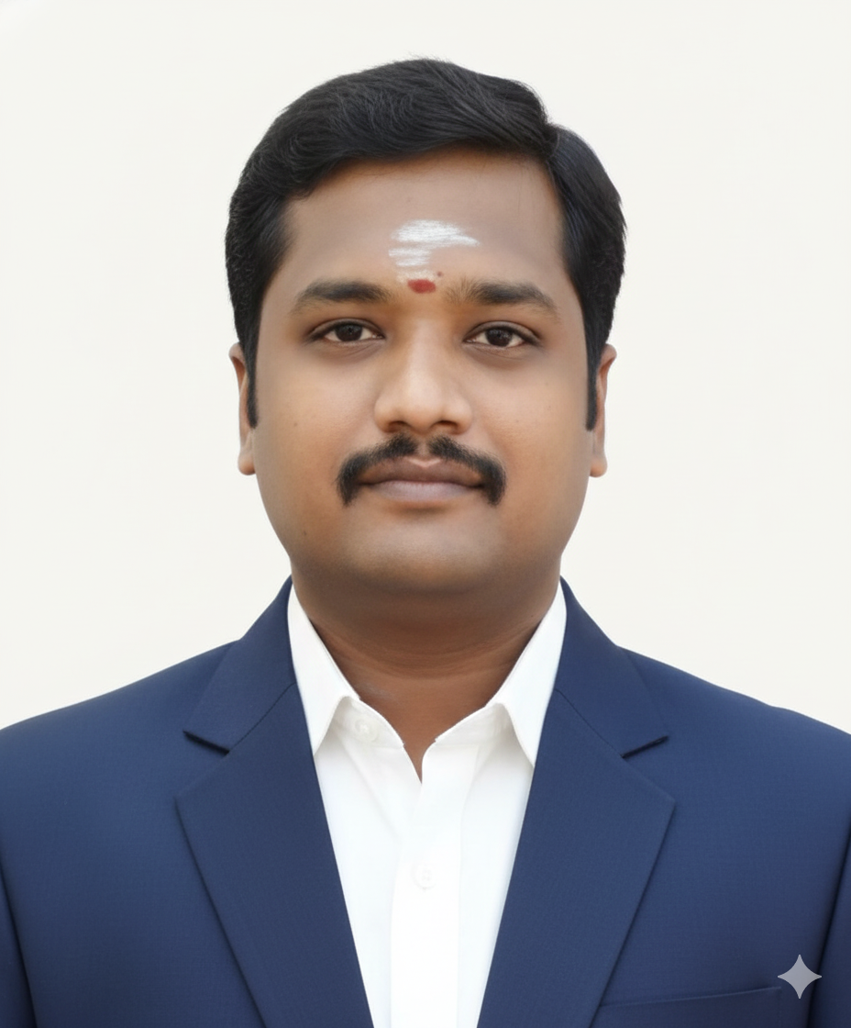
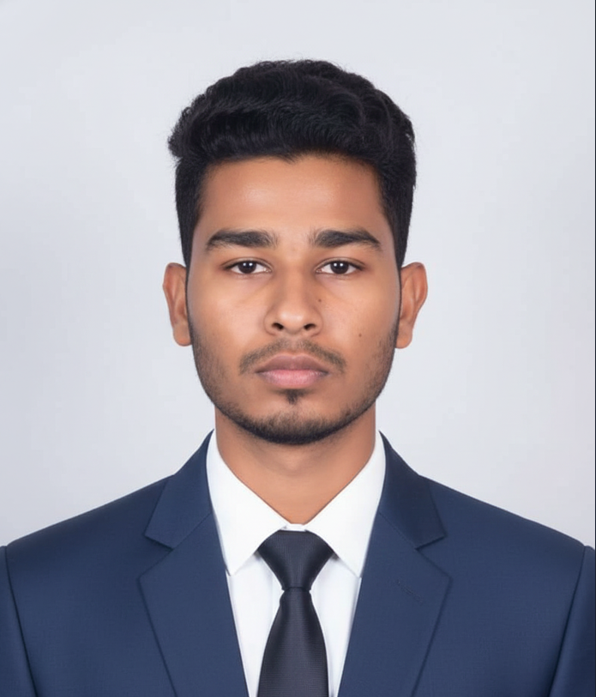
Our Team
Chief Mentor
Business Excellence – Consultant
DGM Central Quality (Rtd.), Ashok Leyland
+91 98415 68728
Sairam D K
T.R Renukanthan
Ramkumar S
Ashok Soundararajan
Founder & CEO
Business Consultant
+91 90030 71320
Senior Consultant
+91 88386 62385
Associate Consultant - Trainee
+91 78128 89891

Slide 3
About Us
Primal Solutions is a consulting firm serving as a catalysts for ”Organization’s Cultural Transformation”. Our focus is on fostering growth and innovation in the automotive sector by working closely with OEMs, Tier-1 suppliers, and component manufacturers.
We help manufacturing companies to enhance operational efficiency, develop strategies, and deliver measurable results that directly impact the bottom line. (Home Page – Hero Section)
Our team of seasoned consultant’s leverage deep industry to drive operational excellence and sustainable change.
Over the next three years, Primal Solutions aims to (About Us – Second Section)
Establish itself as a trusted transformation partner in the automotive ecosystem
Scale from project-based consulting to long-term, end to end transformation engagements
Build strong, differentiated capability in Lean, TQM, TPM, Digital Manufacturing and Leadership Development

Slide 4
Vision & Mission
Our Vision
To be the most trusted transformation partner for MSMEs, automotive, and manufacturing enterprises by solving deep-rooted business challenges and driving sustainable, profitable growth. By 2030, we aspire to transform 100 organizations through operational excellence and cultural change.
Our Mission
“We turn strategy into execution through robust systems, strong leadership, and cultural transformation - delivering measurable impact, industry-ready talent, and sustainable performance for our clients."

Slide 5
Values
Integrity and Ethics:
Act with honesty and fairness, building trust through strong moral principles.
Customer Centric:
Focus on understanding customer needs and delivering solutions that ensure satisfaction.
Result Oriented:
Drive measurable outcomes efficiently while maintaining quality standards.
People Centric:
Empower and value individuals, fostering collaboration and team success.

Slide 6
(Home Page – After Process Section)
Short-Term Projects
Long-Term Projects
(Retainer Model)
Result-oriented, time-bound interventions focused on quick wins and measurable impact
Sustained engagement for continuous improvement, transformation, and capability building
PROJECT & ENGAGEMENT
MODELS
Cluster Projects
Training Program
Government / OEM-driven cluster initiatives for MSMEs, focusing on collective improvement and benchmarking
Institutional and Industry-readiness programs to build practical skills and future-ready capabilities

Slide 7
Services
Business Strategy
Plant Layout Design & Optimization
Operational Excellence & Lean Transformation
Zero Defect Culture Deployment
Digital & Smart Factory Transformation
Supplier Capability and Performance Enhancement
Skill development programs and certifications
Talent Hiring & Management Services

Slide 8
SI No | Services | What We Deliver | What We do | Impact
1 | Business Strategy | 1.Strategic Business Planning 2.Performance-Driven Culture and KPI Deployment 3.Market Entry and Scalable Growth Strategy | We help organizations develop clear strategic business plans aligned with their vision, market dynamics, and long-term objectives. We deploy performance-driven KPIs and build execution-focused cultures to enable successful market entry and scalable, sustainable growth. 1.Build practical strategies that teams can execute with clarity 2.Align leadership and cross-functional teams around shared goals 3. Replace assumptions with data-driven, measurable direction | 1.Faster, data-driven decision-making 2.Clear KPI visibility and performance transparency 3.Strong alignment across leadership and functions 4.Sustainable topline growth through structured growth strategies 5.Improved profitability, margins, and EBITDA performance

Slide 9
SI No | Services | What We Deliver | What We do | Impact
2 | Plant Layout Design & Optimization | 1. New plant layout planning - Greenfield 2. Expansion or Plant Re-Layout - Brownfield 3. Product or Process Layout design | New Plant Layout Planning – Greenfield We design end-to-end plant layouts from concept to commissioning, optimizing material flow, space utilization, and future scalability. Expansion or Plant Re-Layout – Brownfield We re-engineer existing layouts to support capacity expansion, improve flow efficiency, and minimize disruption to ongoing operations. Product or Process Layout Design We develop optimized product- and process-based layouts to reduce lead time, handling cost, and operational bottlenecks. | Design efficient plant layouts for smooth operations. Streamline material flow and optimize processes. Maximize space utilization for current and future needs. Provide a clear roadmap for seamless implementation. Deliver cost savings and improved operational performance.

Slide 10
SI No | Services | What We Deliver | What We do | Impact
3 | Operational Excellence & Lean Transformation | Lean Manufacturing Implementation Process Optimization & Line Efficiency Improvement 5S & Workplace Organization with Change Management | Lean Manufacturing Implementation Embed lean principles to eliminate waste and improve overall efficiency. Process Optimization & Line Efficiency Improvement Streamline processes to boost productivity and reduce cycle time. 5S & Workplace Organization with Change Management Organize workplaces systematically and drive sustainable behavioral change. | Implement lean practices to eliminate waste and improve efficiency. Optimize processes and enhance production line performance. Organize workplaces using 5S for better safety and productivity. Improve overall operational performance and reduce costs. Drive sustainable change through structured change management.

Slide 11
SI No | Services | What We Deliver | What We do | Impact
4 | Zero Defect Culture Deployment | Quality Management System Strengthening Established Quality Systems and Practices through “3D Concept” Continuous Improvement & Problem-Solving Culture | Quality Management System Strengthening Strengthen QMS to ensure consistent product quality and compliance. Implement structured quality practices using the 3D Concept for defect prevention. DON’T PASS DEFECT - INSPECTION DON’T MAKE DEFECT - ASSURANCE BY PROCESS CAPABILITY DON’T ACCEPT DEFECT - TIER II CONTROL Establish robust DWM systems and practices to strengthen daily monitoring and problem-solving capabilities. Continuous Improvement & Problem-Solving Culture Foster a culture of ongoing improvement and proactive problem-solving. | To achieve Zero Customer PPM 50% reduction in COPQ (FE & FI) from the current level To improve Customer audit score >85%

Slide 12
SI No | Services | What We Deliver | What We do | Impact
5 | Digital & Smart Factory Transformation | Integrated Digitalization and Visual Control Systems (VCS). Digital Quality Management System (DQMS) Advanced Analytics & Predictive Maintenance | Integrated Digitalization and Visual Control Systems (VCS) Implement smart digital systems for real-time monitoring and control. Digital Quality Management System (DQMS) Digitize quality processes to ensure compliance and traceability. Advanced Analytics & Predictive Maintenance Use data analytics to predict failures and optimize maintenance. | Digitize quality management for compliance. Enable predictive maintenance with analytics. Deliver insights to boost efficiency. Drive smart factory transformation.

Slide 13
SI No | Services | What We Deliver | What We do | Impact
6 | Supplier Capability and Performance Enhancement | Enhance Supplier Capability & Performance Improving OEM Performance Ranking for Tier I Suppliers Supplier Capability Enhancement Cluster Program | Enhance Supplier Capability & Performance Improve supplier processes, skills, and delivery performance. Improving OEM Performance Ranking for Tier I Suppliers Help suppliers meet OEM standards and boost their performance ranking. Supplier Capability Enhancement Cluster Program Develop supplier clusters for shared learning, best practices, and performance improvement. | Improve supplier processes and quality. Enhance skills and operational capabilities. Boost OEM performance rankings. Enable cluster-based learning and best practices. Drive sustained supplier performance.

Slide 14
SI No | Services | What We Deliver | What We do | Impact
7 | Skill development programs and certifications | AIAG - Core Tools, Lean Tools, Problem solving through disciplinary approach ESG Implementation ISO, IATF and Integrated certification for manufacturing | AIAG – Core Tools, Lean Tools, Problem Solving Train teams in core manufacturing and problem-solving skills. ESG Implementation Guide organizations to implement sustainable and responsible practices. ISO, IATF, and Integrated Certification Support certification readiness and compliance for manufacturing standards. | Build structured problem-solving skills. Implement ESG and sustainability practices. Support ISO, IATF, and integrated certifications. Enhance skills and operational excellence.

Slide 15
SI No | Services | What We Deliver | What We do | Impact
8 | Talent Hiring & Management Services | Strategic Talent Acquisition Leadership & High-Potential Talent Development Employee Engagement & Retention Programs | Talent Acquisition Strategy & Planning – Define hiring strategies aligned with business goals. Competency Mapping & Role Profiling – Identify skills and competencies required for roles. Leadership & High-Potential Talent Development – Develop programs for future leaders. Performance Management System Design – Implement frameworks to measure and improve performance. Employee Engagement & Retention Programs – Boost workforce motivation and reduce attrition. | Reduce attrition rate Deploy scalable HR performance management systems

